Slide 1
Creating a Culture of Quality: Developing the Infrastructure to Meet Quality Improvement Requirements
C
C
Q
Creating a Culture of Quality
Judith Kari, Technical Director
ESRD Program
Survey & Certification Group, CMS

Slide 2
Collaboration in Renal Field: STUNNING
Fistula First Initiative
Emergency Response to Katrina & Hurricanes of 2005

Slide 3
Collaboration Works!
Renal Community knows it works
Networks know it works
CMS knows it works

Slide 4
So Why is Collaboration Difficult?
We work in organizations with hierarchical structures for accountability
We have different perspectives
We use routines and control to prevent chaos
We like to succeed without conflict (if possible)

Slide 5
Perspectives on Collaboration from the Survey & Certification Group
Open Dialogue
Vision and Purpose
A Continually Changing Reality
Constructive Authority

Slide 6
Open Dialogue
Open the dialogue to all
Deal with conflicts
Recognize not all conflicts can be resolved
Consider all positions
Clarify facts, analyses, decisions

Slide 7
Vision and Purpose
Focus on the Triple Aim
Focus on solutions not problems
Focus on the “common good”

Slide 8
A Continually Changing Reality
Be aware and responsive to the changing environment
“Skate to where the puck is going to be not where it is” (Wayne Gretsky)

Slide 9
Constructive Authority
Understand the issues/conflicts
Communicate the basis/legitimacy of the rules
Clarify the expectations

Slide 10
Efforts on Future Collaborations
Use the “Agency-Wide Renal Action Plan” as a template for collaboration
Embrace: All Teach; All Learn
Listening/communicating with renal community
Using “Open Space” concept at surveyor training
Leveraging Network and State oversight roles
Celebrate the NOTICE Initiative (National Opportunity to Improve Infection Control in ESRD)

Slide 11
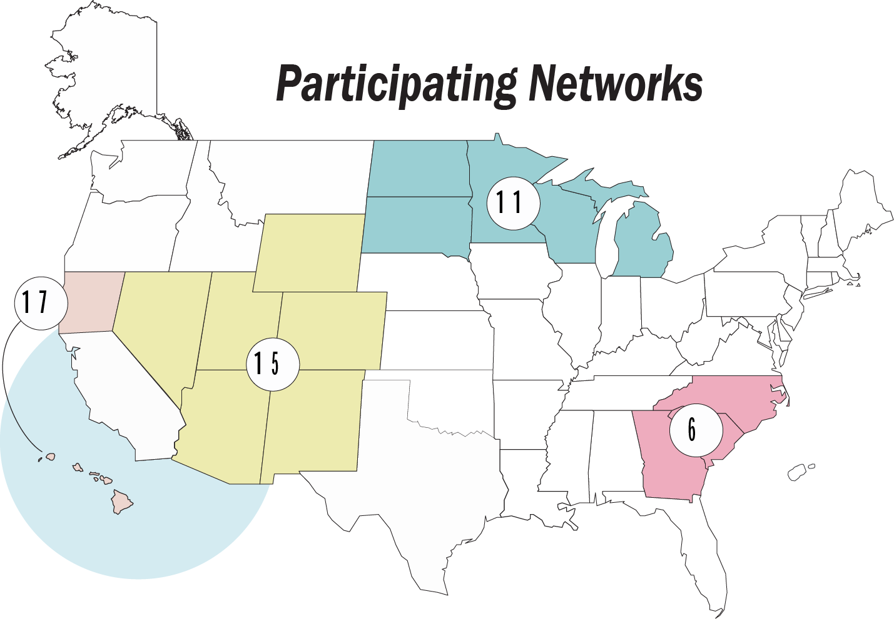
Improving Infection Control Practices in ESRD Facilities
Geographic and Population Representation Networks 6, 11, and 15/17
ESRD Network | States | Number of Dialysis Facilities | Number of Dialysis Patients
6 | GA, NC, SC | 561 | 37,141
11 | MI, MN, ND, SD, WI | 437 | 23,313
15 | AZ, CO, NV, NM, UT, WY | 299 | 18,111
17 | Northern CA, HI, Pacific Islands | 218 | 20,796
Subtotals | 16 states | 1,515 | 99,361
USA | 50 states | 5,580 | 386940
Percent of USA | 32% | 27% | 26%
Data based on Network 2009 Annual Reports

Slide 12
Thank you for the Opportunity to Collaborate on Creating a Culture of Quality
C
C
Q
Creating a Culture of Quality

